Slide 1

Pokémon Analytics
Wyatt Prall
Bryan Zack
Zack Supple

Slide 2


Who is the best Pokemon
Goal of project is to determine what characteristics make up the best Pokemon and predict which Pokemon are the strongest

Slide 3


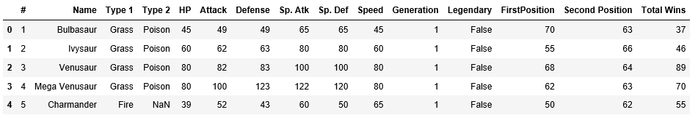
Dataset Description
The information was found on the website Kaggle. It contains the list of Pokemon and battle statistics. The data was downloaded from Kaggle.
Attack: This describes how much damage the Pokemon does with each normal attack¶
Defense: This is used to explain how much damage can be absorbed before the attack depletes the hp points¶
Sp. Atk: This stands for special attack damage¶
Sp. Def: This stands for special attack defense¶
Speed: This determines how quickly a Pokémon can attack¶
Generation: This determines what game that the Pokemon was first introduced in¶
Legendary: This determines if the Pokemon is of legendary status or not¶
FirstPostion: During the 50,000 simulated battles this determines how many times the Pokemon was in attack Position one¶
SecondPostion: During the 50,000 simulated battles this determines how many times the Pokemon was in attack Position two¶

Slide 4



Data cleaning

Slide 5
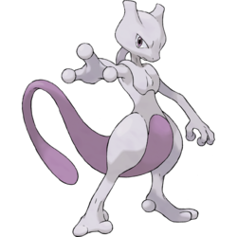

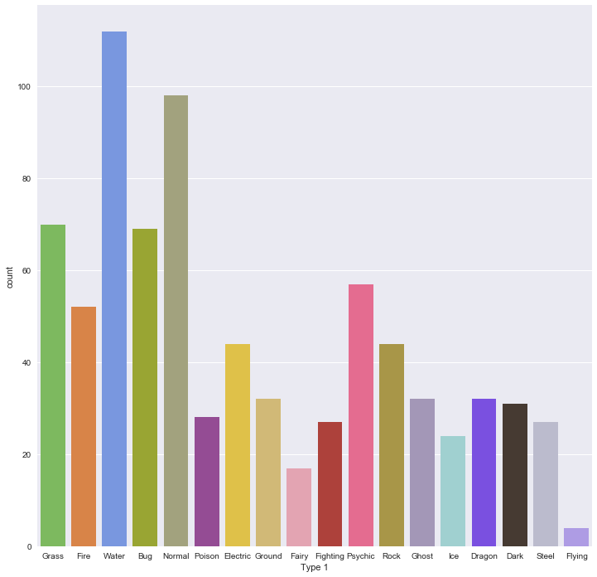
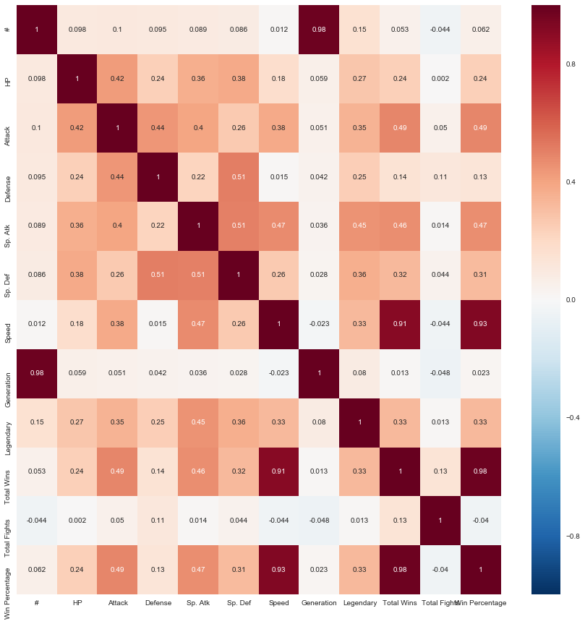
Data Visualization

Slide 6
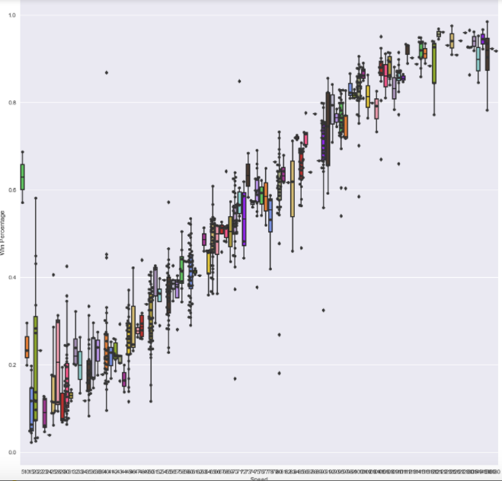
Speed vs. Win Percentage
Notes:
As you can see there is positive trend between speed and win percentage. That being said there is an outlier at the beginning that has practically no speed but a decent win percentage.

Slide 7

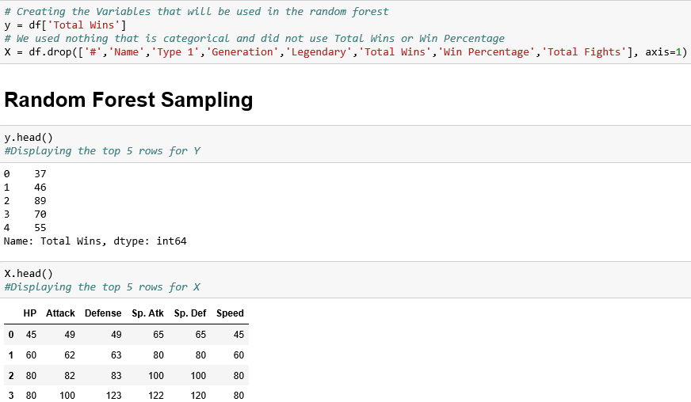

What makes for a good Pokemon
We used Random Forest Sampler
This model has a 97% accuracy

Slide 8

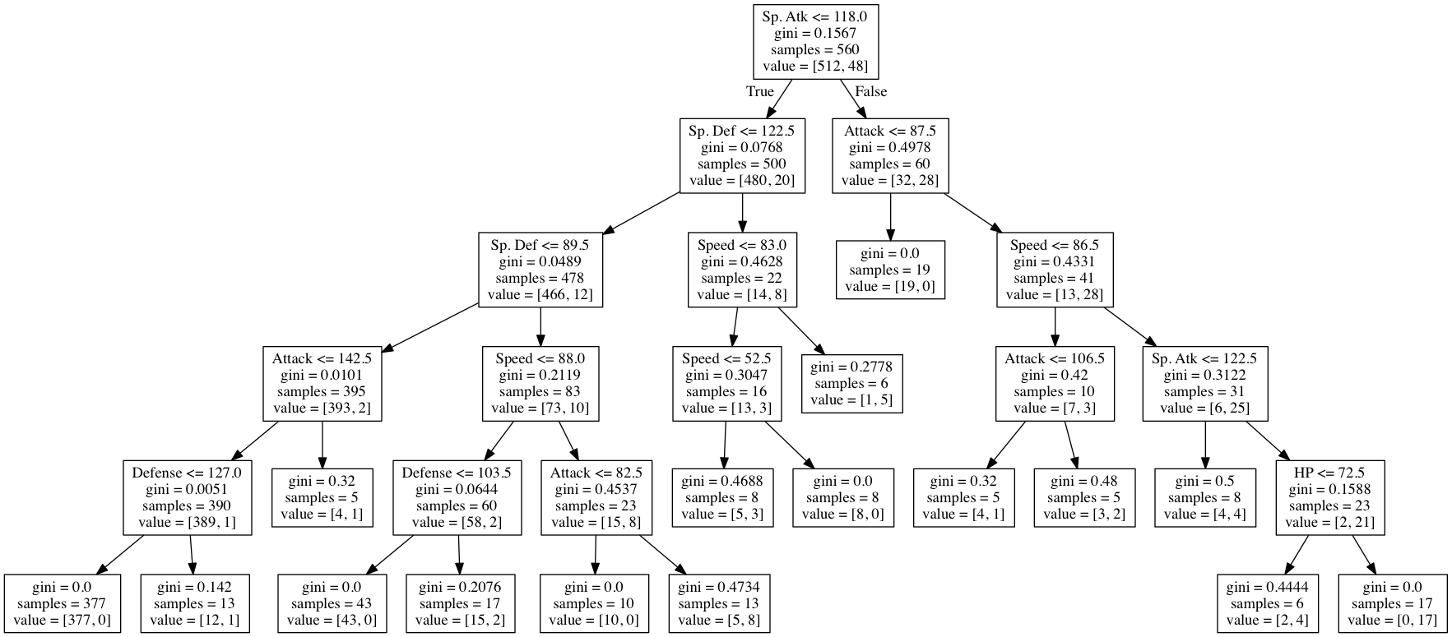
Decision Tree

Slide 9
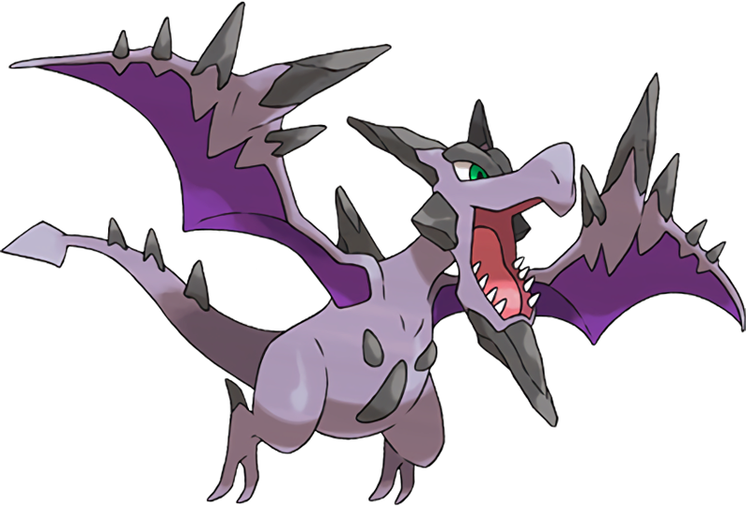




Best Pokemon
Mega Aerodactyl- 98.44%
Weavile- 97.47%
Tornadus Therian- 96.80%
Mega Beedrill- 96.63%
Aerodactyl- 96.45%

Slide 10





Worst Pokemon
Munna 3.9%
Slugma 3.3%
Solosis 3.1%
Togepi 2.6%
Silcoon 2.2%

Slide 11

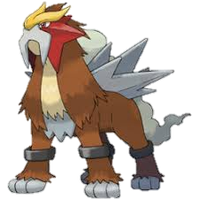

Key Findings
From the data analytics that were performed above we have come to the conclusion that speed is the best attribute to have to win a battle and then Attack is second best.
After doing a decision tree analysis the special attack of a pokemon was the biggest factor to determine if they are legendary or not.
Finally we wanted to see what were the top and bottom five pokemon based in win percentage and total wins. We wanted to look at both because some pokemon battled more than others in the data set.

Slide 12

